Slide 1

CREDIT CARD FRAUD DETECTION USING MACHINE LEARNING
Internship Project Report
Presented by :
Madasu Harshini

Slide 2
Introduction
Credit card fraud is a growing problem in digital banking and online payments.
Detecting fraudulent transactions manually is difficult due to the large volume of transactions.
Machine Learning helps identify suspicious activities automatically.
This project builds a model to classify transactions as genuine or fraudulent.
The goal is to improve transaction security and minimize financial losses.

Slide 3
Problem statement and Objectives
Problem Statement :
Increasing online transactions have led to more credit card fraud cases.
Manual detection is difficult and time-consuming.
Need an automated system to identify fraudulent transactions accurately.
Objectives :
Detect fraudulent credit card transactions.
Analyse transaction patterns using Machine Learning.
Improve fraud detection accuracy.
Reduce financial losses.
Enhance payment security.

Slide 4
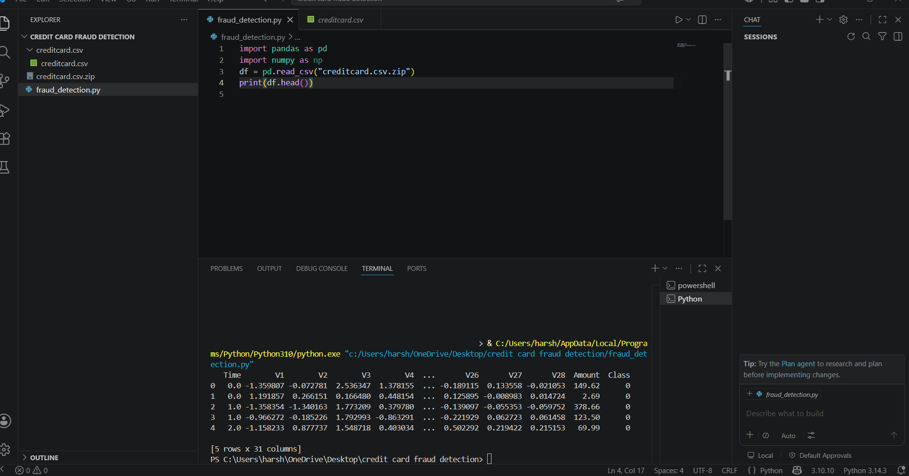
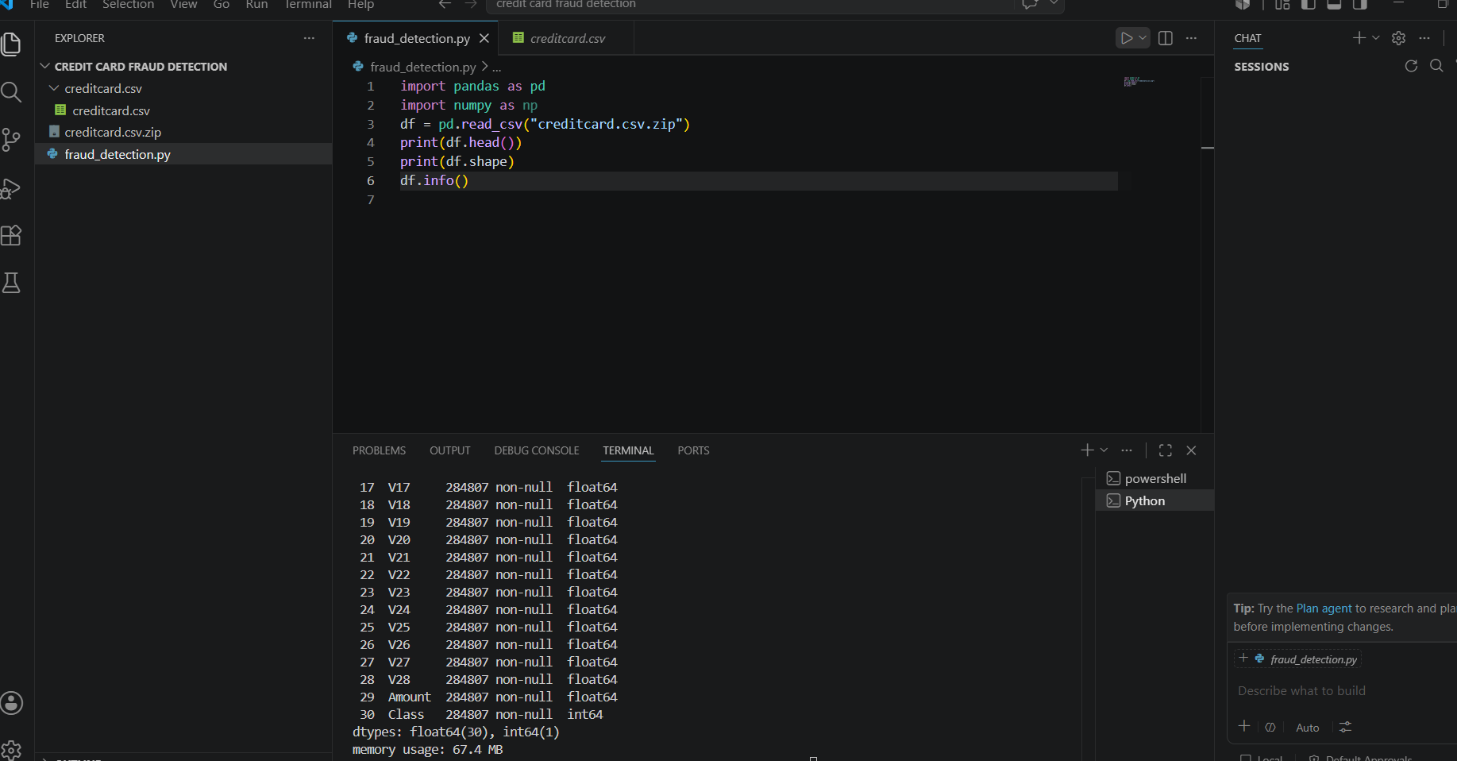
Data Description
Class Labels :
Class 0 → Genuine Transaction
Class 1 → Fraud Transaction
Dataset Information :
Attribute | Value
Total Records | 284,807
Features | 30
Target Variable | Class
Fraud Transactions | 492
Genuine Transactions | 284,315

Slide 5
Tools and Technologies Used
Software :
Visual Studio Code
Python 3.10
Libraries :
Pandas
NumPy
Matplotlib
Seaborn
Scikit-Learn
Machine Learning Algorithm :
Random Forest Classifier

Slide 6
Methodology
Dataset Collection
↓
Data Preprocessing
↓
Exploratory Data Analysis
↓
Train-Test Split
↓
Random Forest Training
↓
Prediction
↓
Model Evaluation

Slide 7
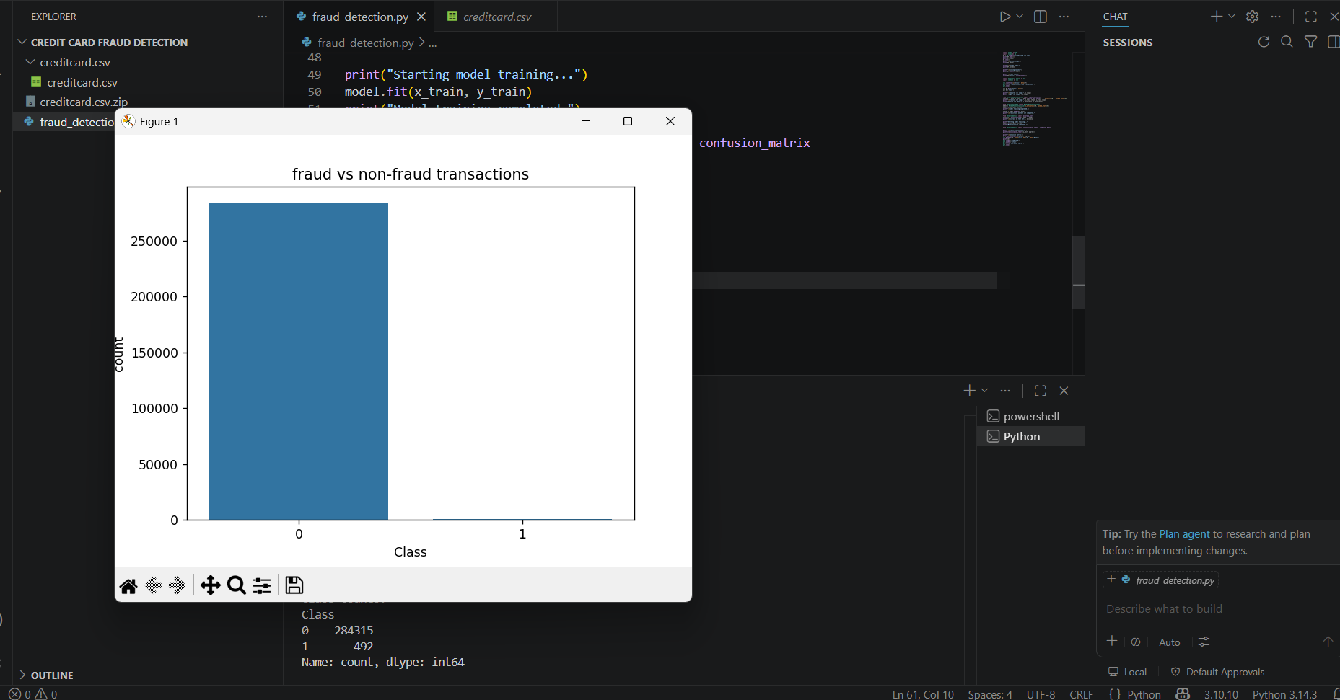
Data Analyses and Visualization
Dataset Analysis :
Dataset contains 31 columns.
No missing values found.
Dataset is highly imbalanced.
Class Distribution :
Class | Count
Genuine (0) | 284,315
Fraud (1) | 492

Slide 8
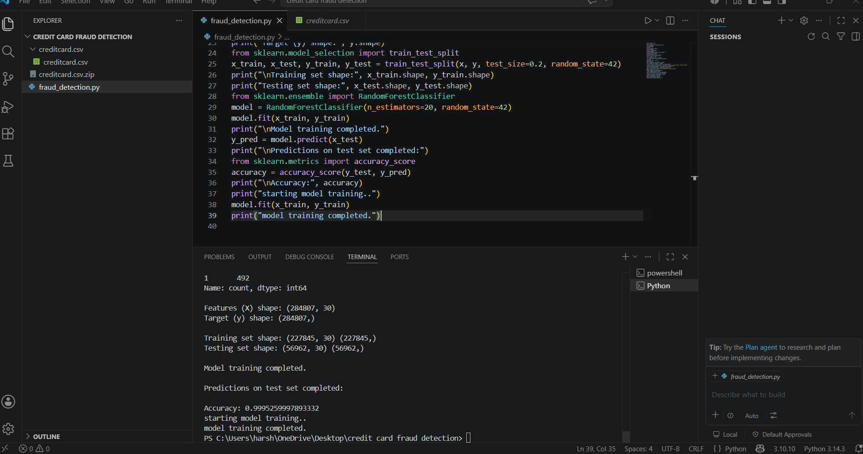
Model Training
Preprocess the dataset and selected features.
Split data into training and testing sets.
Trained a Machine Learning classification model.
Learned patterns from historical transaction data.
Evaluated using Accuracy, Precision, Recall, F1-Score, and Confusion Matrix.
Used the trained model to predict fraudulent transactions.

Slide 9
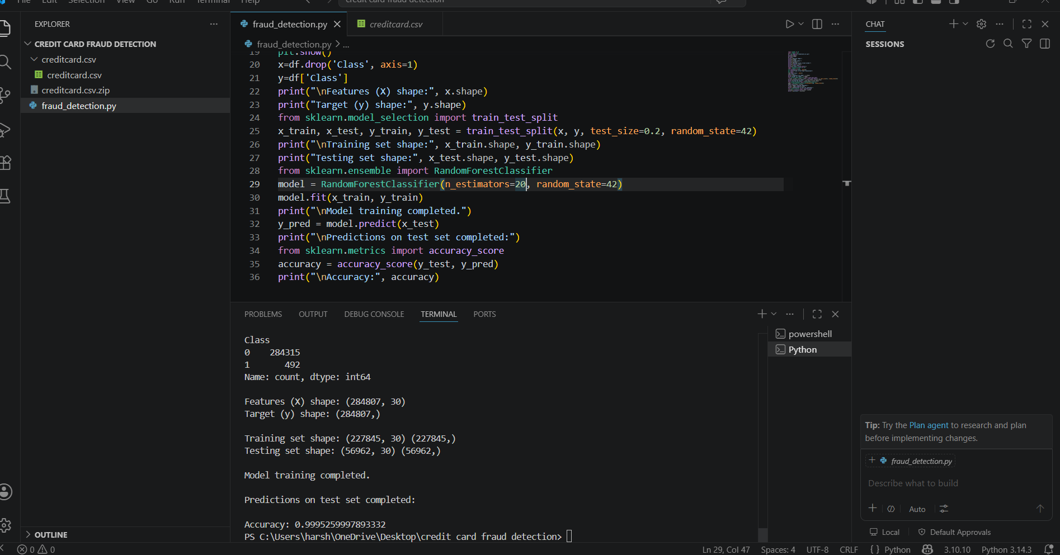
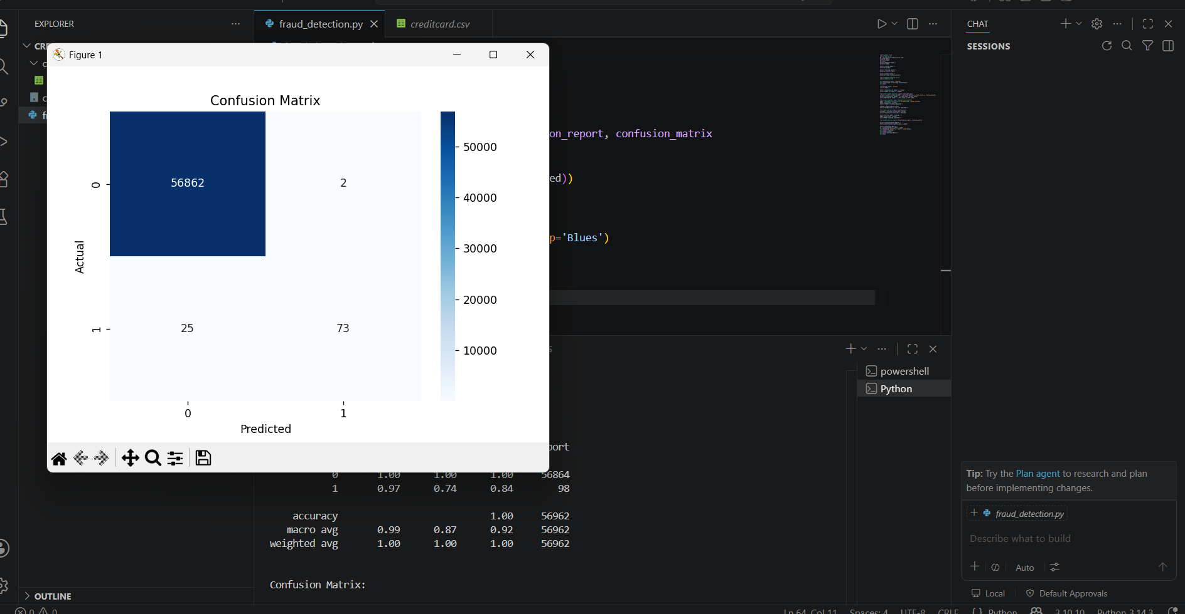
Results and Performance
Model Accuracy :
Accuracy = 99.95%
Classification Report :
Metric | Class 0 | Class 1
Precision | 1.00 | 0.97
Recall | 1.00 | 0.74
F1-Score | 1.00 | 0.84

Slide 10
Conclusion and Future Scope
Conclusion :
Successfully developed a Credit Card Fraud Detection System.
Random Forest model achieved 99.95% accuracy.
Fraudulent transactions were detected effectively.
Machine Learning can improve financial transaction security.
Future Scope :
Real-time fraud detection
Deep learning implementation
Web application deployment
Integration with banking systems

Slide 11


